Slide 1
Technical Support (420-1N6-AB) Peripheral Devices
Fall 2023

Slide 2
Outline
Input devices:
Keyboards
Mice
Output devices:
Monitors
Projectors
Printers

Slide 3
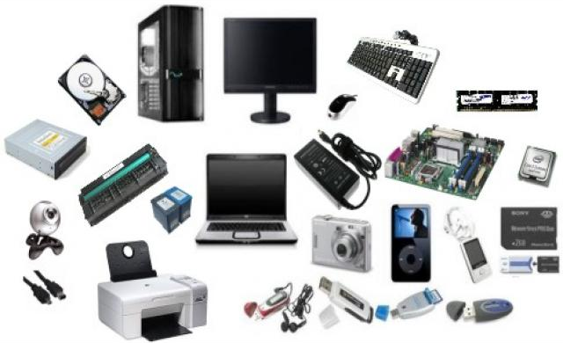
Hardware vs Software
Hardware
The physical components that make up a computer system.

Slide 4

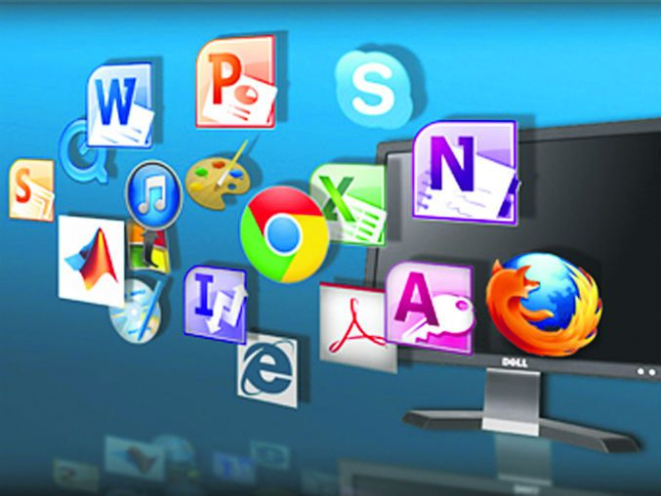
Hardware vs Software
Software
The programs (instructions) that tell the computer (the hardware) what to do.

Slide 5
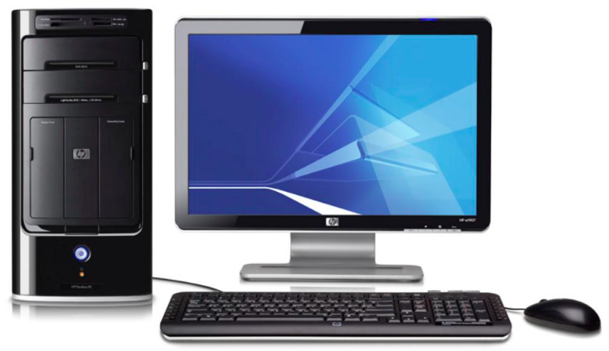
Computer Basics
Input devices
Mouse, keyboard, gamepads, biometric devices, cameras, touchscreens, scanners, digitizers, media readers.
Output devices
Monitors, printers, speakers.
Storage devices
Connectors / ports
Assignment 1 – Lab1 : activity about each

Slide 6
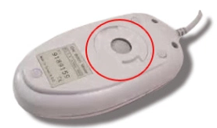
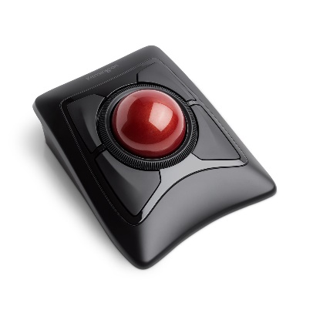
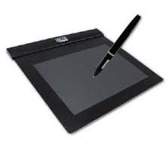
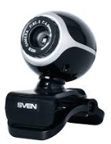
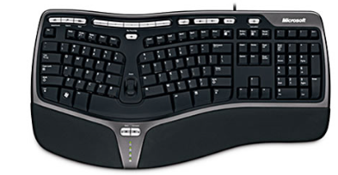
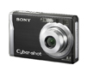
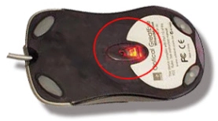
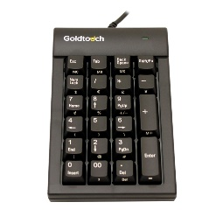
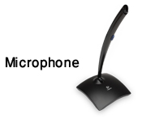

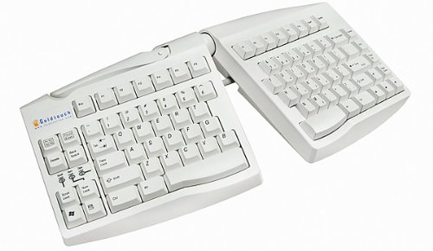
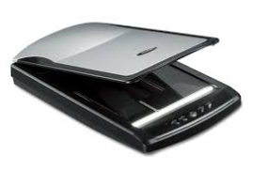
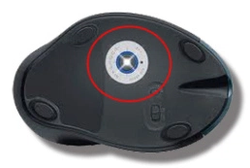

Input Devices
Allow a computer to accept data and instructions from a user.

Slide 7
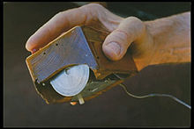
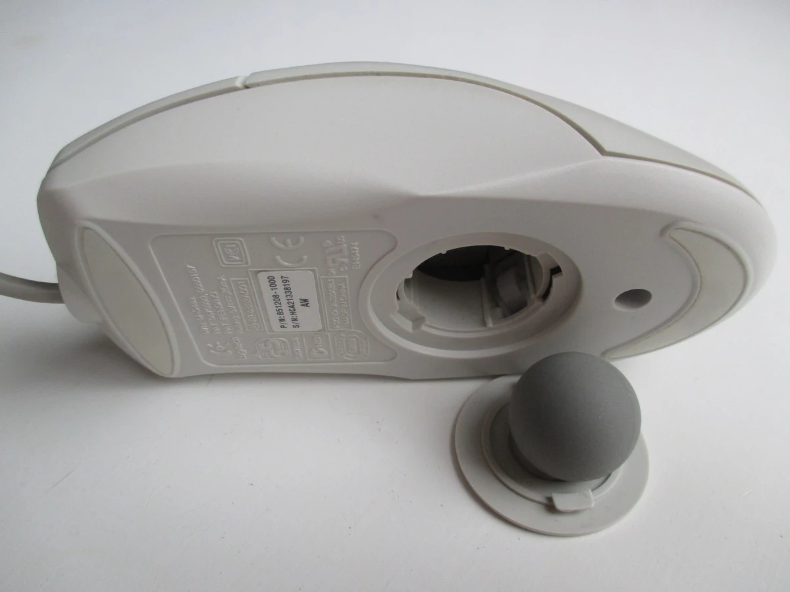
Input Devices: Mouse
Used to navigate the graphical user interface (GUI).
There are many types of mice, distinguished by tracking technology and by use case
Technologies:
Mechanical mice use a ball to measure movement (obsolete now)
Optical mice use light sources (first LED, then the more precise Laser)
Purposes:
Many! “Gaming” (many buttons), Ergonomic (optimize human comfort), etc.
Notes:
Good notes on history and explanation of how/why they work “Optical mice use image sensors to image naturally occurring texture [on the surface they are placed].... These surfaces, when lit at a grazing angle by a light emitting diode, cast distinct shadows that resemble a hilly terrain lit at sunset. Images of these surfaces are captured in continuous succession and compared with each other to determine how far the mouse has moved. “
https://en.wikipedia.org/wiki/Computer_mouse
https://en.wikipedia.org/wiki/Optical_mouse

Slide 8
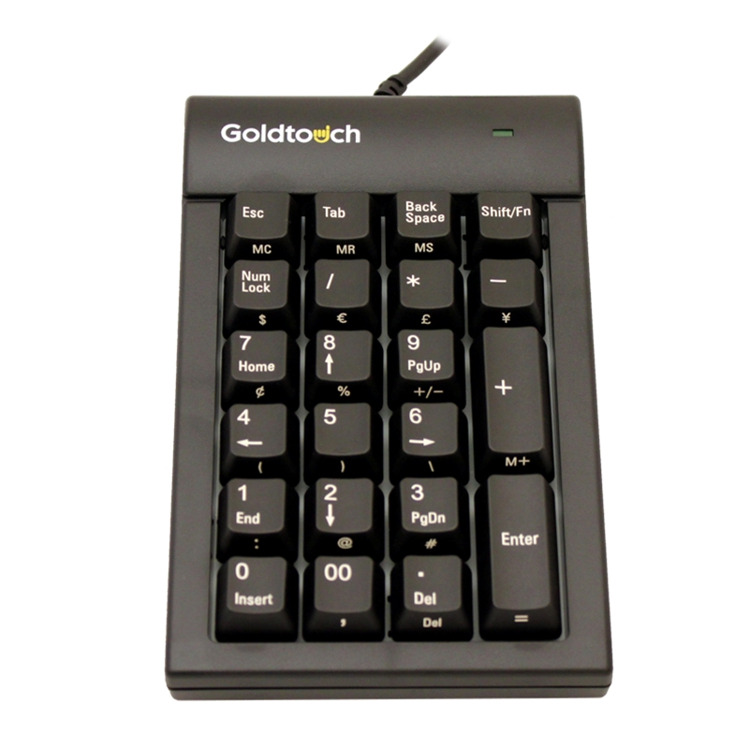
Input Devices: Keyboard
Used to enter text commands.
Most commonly used is the QWERTY layout (1873).
Other layouts include QWERTZ (Germany/Switzerland) and AZERTY (France) and DVORAK (nerds*)
Variations include wired or wireless keyboards and numeric keypads.
Ergonomic designs are recently becoming more popular.
KVM ("keyboard, video and mouse"): control multiple devices from one keyboard/mouse combination
* note: this is very hypocritical coming from me. don’t mind my bad jokes!

Slide 9
Input Devices: Others
Gamepads or joysticks are used for playing games and running simulations.
Digital / video cameras and webcams create images and videos.
Microphones
Biometric devices use features unique to an individual user (e.g. fingerprint).
Touchscreens have a pressure-sensitive panel.
Scanners digitize images or documents so they can be stored as files.
Digital Tablets (sometimes called Digitizers) allow the user to create images or artwork using a stylus.
Media card readers read/write data from/to different types of media cards (SD cards, video game cartridges, etc.)

Slide 10
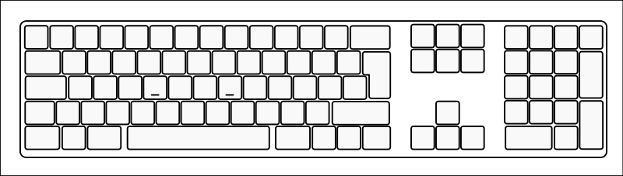
Activity: How Well Do You Know Your Keyboard?
Fill in the blank keyboard as best as you can. Then answer:
Pick 5 keys (that aren’t letters or numbers) and try explain their general purpose. Pick keys that you aren’t sure about and use your lab computer to research! With 1 or 2 partners, compare and discuss your answers.

Slide 11
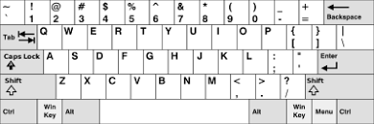
Activity: How Well Do You Know Your Keyboard?
Windows keybpard shortcuts

Slide 12

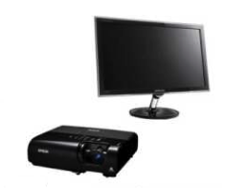
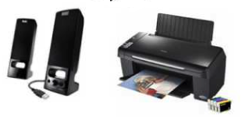
Output Devices
Output devices present information to the user from a computer.
Monitors
Projectors
Printers
Speakers
Headphones

Slide 13
Output Devices: Monitors
Different types of monitors use different technologies to create an image.
However, the common principles are the same:
Digital representation of image to display is sent to the monitor
The monitor produces each pixel (the “atom” of monitor displays) using some deterministic physical technology
Light from the monitor reaches us as a useful/pleasing image.
The following slides are the main technologies used today (from oldest to latest)

Slide 14
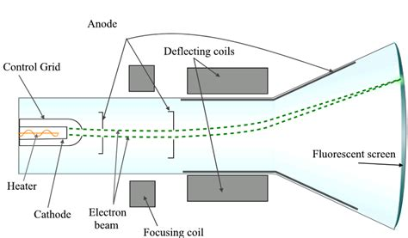
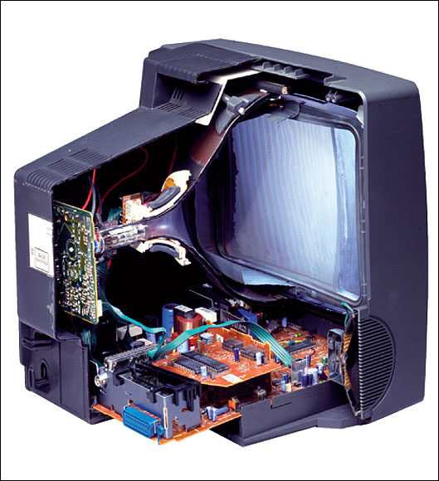
Output Devices: Monitors (CRT)
CRT (Cathode ray tube)
The most common type of consumer and industry television before ~2010
A tungsten coil is heated in a vacuum until it sheds electrons, those electrons are accelerated by an electric field and guided by magnets to hit a phosphor coated glass display to emit light in a pixel grid
Obsolete since today there are lighter, simpler higher resolution technologies
Still used today for some applications due to zero latency. For instance, I use one for playing NES Tetris!

Slide 15
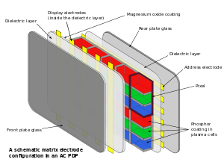
Output Devices: Monitors (Plasma)
Plasma
Tiny cells of ionized gas that light up when stimulated by electricity.
Often used in home theatre applications due to accurate video representation.
High levels of brightness, deep black levels and very wide color range.
Have shorter life span, susceptible to “screen burn-in” (this is why screensavers are called “screen savers”! Same for CRT).
(+) Plasma cell will produce light that looks good from every angle, it was high refresh rate (videos are smoother)
(-) BUT! Consumes a lot of electricity
(-) Doesn’t work at high altitudes! (low pressure)
Notes:
Plasma is a chemical state of molecules when molecules in state of gas are heated up (excited with electric charge).
Typical Plasma displays have two glass plates sandwiching hundreds of thousands of cells containing plasma.
Two sets of electrodes will provide some charges which will excite the plasma
Which will release photons at three different wavelength (either red, green or blue)

Slide 16
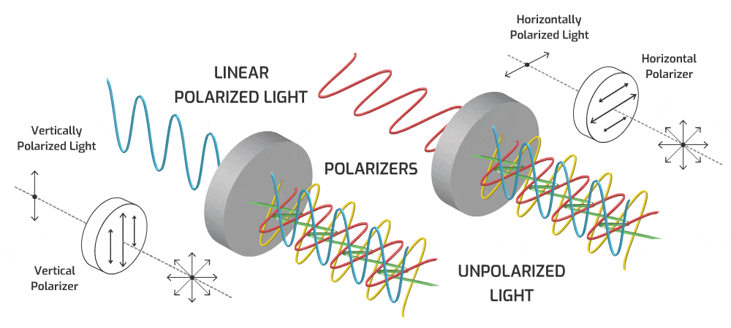
Pause on Monitors- Let’s talk physics first!

Slide 17
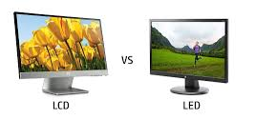
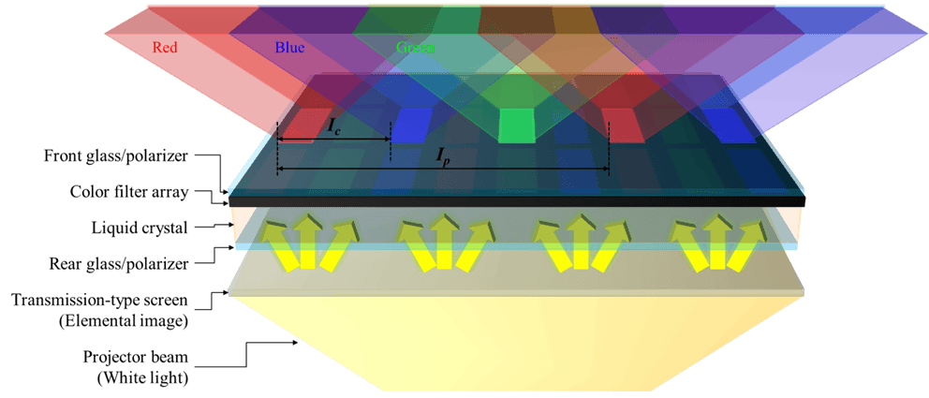
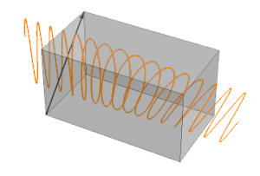
Output Devices: Monitors (LCD)
LCD (Liquid crystal display)
Commonly used in flat panel monitors and laptops.
Consists of a white backlight (in light, white = all color's combined), two polarizing filters, and liquid crystal solution between them to transform the backlight into a coherent pixel grid.
An electronic current aligns and controls the crystals so that light can pass through them.
(+) Allows to have flat screens!
For more information: https://www.youtube.com/watch?v=Gx-JVoOFYhs&ab_channel=e-learning%C3%A9lectronique
Notes:
An LCD Screen is made up of layers of very thin glass (2), liquid crystal (5um), metal and dielectrics
Liquid cystal is a modelcule between liquid (not ordered and constant motion) and crystal (ordered fashion)
Liquid crytsal is organic (made of carbone and oxygen), they can be smectic (parallel), nematic (same direction not layered), cholesteric (helix order)
LCD TN (Twistic nematic) cheapest
The polarizing filter lets only one orientation of the light pass through.
To transform the white light into colored light, a color filter is placed on the outter face ( made of pigments which will absorb all colors execept the color that is passing (red, blue or green)

Slide 18
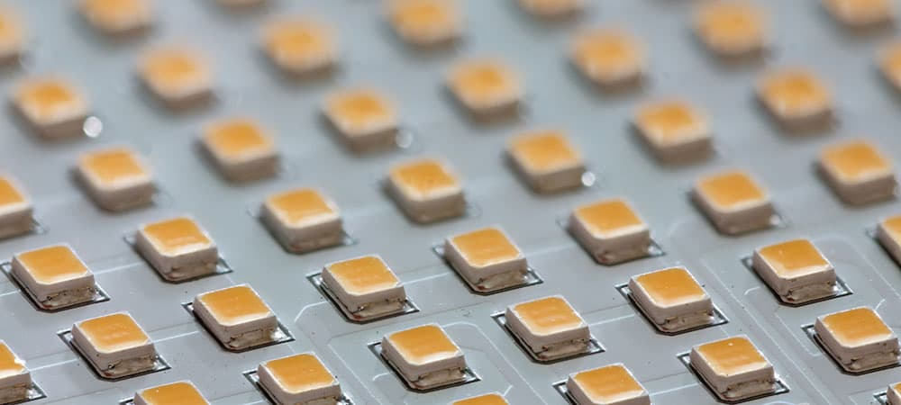
Output Devices: Monitors (LED)
LED (Light emitting diode)
Same as LCD but uses LED backlighting instead of a white backlight with crystal liquid to light the display.
The brightness of each RGB LED is controlled programmatically to produce each pixel
(+) Thinner (no layers), lighter and brighter, and displays better contrast
(+) Lower power consumption.
LED backlight
For more information: https://www.youtube.com/watch?v=96QwqOZ4xjE&ab_channel=Lesics

Slide 19
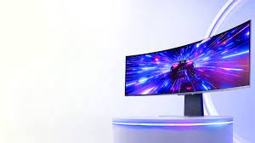
Output Devices: Monitors (OLED)
OLED (Organic LED)
Similar to LED, but no backlighting required -- the material used to create these displays emits light when an electrical current is applied.
(+)Allows for perfect representation of dark colors unlike all other monitor technologies. Also allows for flexible and transparent monitors
(-)More expensive to produce, more susceptible to screen-burn-in than LCD or LED (but better than Plasma and CRT in this respect)
For more information: https://www.youtube.com/watch?v=xAMhX3Drq14&ab_channel=Lesics

Slide 20
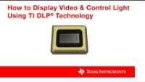
Output Devices: Monitors (DLP)
DLP (Digital light processing)
Used in projectors.
Spinning color wheel with microprocessor-controlled array of mirrors.
Each mirror corresponds to a specific pixel, reflecting light.
Monochrome image is created using up to 1024 shades of grey.
Color wheel then adds to complete the projected image.

Slide 21
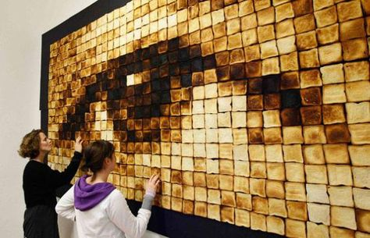
Output Devices: Printers
Printers take data from a computer and generate output on paper.
Basic principles
Similar to monitor (high quantity of small, well placed “pixels” → the visual quality of a coherent image)
Rather than orienting light photons on a screen, printers deposit liquid stains on to paper. The physical setup is different, but the same principles are at work.
A high enough quantity of toasted bread produces the qualitative impression of a human eye in this “piece” of art. Printers (and monitors) use much higher quantities of “pixels” than depicted here!

Slide 22
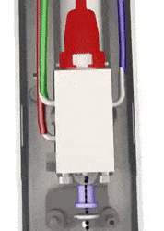
Output Devices: Inkjet Printers
Uses tiny droplets of ink to produce images.
Uses cyan, magenta and blue instead of RGB like screens!
Heat is applied to an ink reservoir, which pushes ink bubbles through a nozzle in a controlled manner.
The ink liquid droplets are smaller in diameter than a human hair! Many of these added together produce the quality of a coherent image.

Slide 23
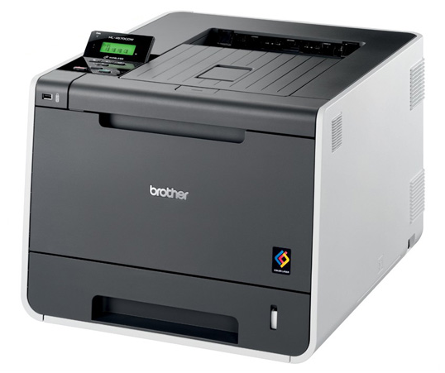
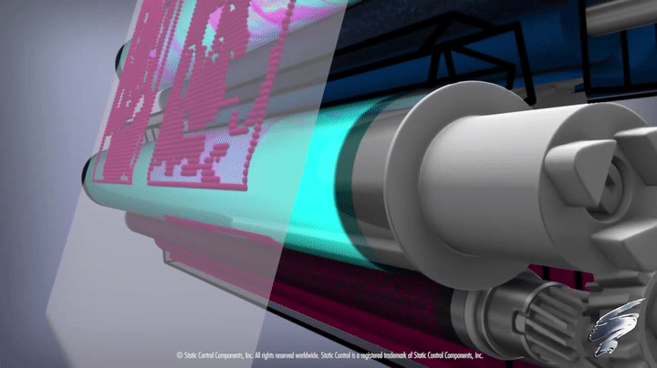
Output Devices: Laser Printers
Expensive when they were initially introduced.
Produce high-quality output quietly at a high speed.
Produces images by directing a laser beam at a mirror which bounces the beam onto a drum.
The drum contains a special coating to which the toner (ink powder) sticks.
A laser beam then conveys information to the drum, neutralizing and detaching some toner.
As the paper rolls by the drum, the toner is transferred onto the paper. A hot roller then bonds toner to the paper.

Slide 24
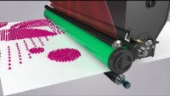
Output Devices: Laser Printers (cont.)

